Slide 1
Host Genetics of HCV: Relevance for the study of HCV in Africa
Thomas J. Urban, PharmD, PhD
Center for Human Genome Variation
Duke University Medical Center
Durham, NC, USA

Slide 2
Natural History of HCV Infection
100 patients
Resolve 20-50%
Chronic Hepatitis 50-80%
WHY????

Slide 3
Natural History of HCV Infection
Resolve 20-50%
Chronic Hepatitis 50-80%
Stable 70-80%
Cirrhosis 20-30%
STAGE 0
STAGE 1
STAGE 2
STAGE 3
STAGE 4
STAGE 0
STAGE 1
STAGE 2
STAGE 3
STAGE 4
NO FIBROSIS
PORTAL FIBROSIS
FEW SEPTA
NUMEROUS SEPTA
CIRRHOSIS

Slide 4
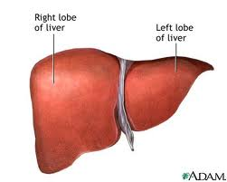
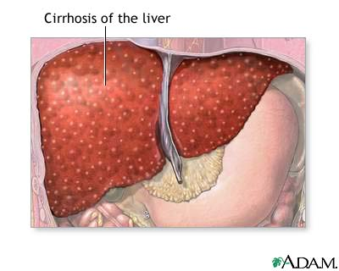
Natural History of HCV Infection
Resolve 20-50%
Chronic Hepatitis 50-80%
Stable 70-80%
Cirrhosis 20-30%
???

Slide 5
Variation in PegIFN + ribavirin treatment in HCV infection: a window into host genetics of HCV
Efficacy | Adverse Effects
• Only 40-50% of patients with genotype 1 HCV show sustained virological response (SVR) | • Long, arduous course of treatment (48 week regimen)
• Treatment is over 2X more effective in groups of European vs. African descent with genotype 1 HCV | • Treatment limiting adverse effects including anemia

Slide 6
Genome-wide association study for predictors of treatment response in the IDEAL trial
Sample populations
Genome-wide genotyping of:
1604 IDEAL participants + 67 participants from Muir et al., 2004
Exclude samples not matching phenotype criteria
1615 samples included in subsequent analyses
Exclude samples not meeting treatment compliance and quality control criteria: gender specification, cryptic relatedness, …
1137 samples included in analysis for association with treatment response, concentrating on sustained virological response (SVR)
SNPs
A series of quality control steps resulted in 565,759 polymorphisms for the association tests.

Slide 7
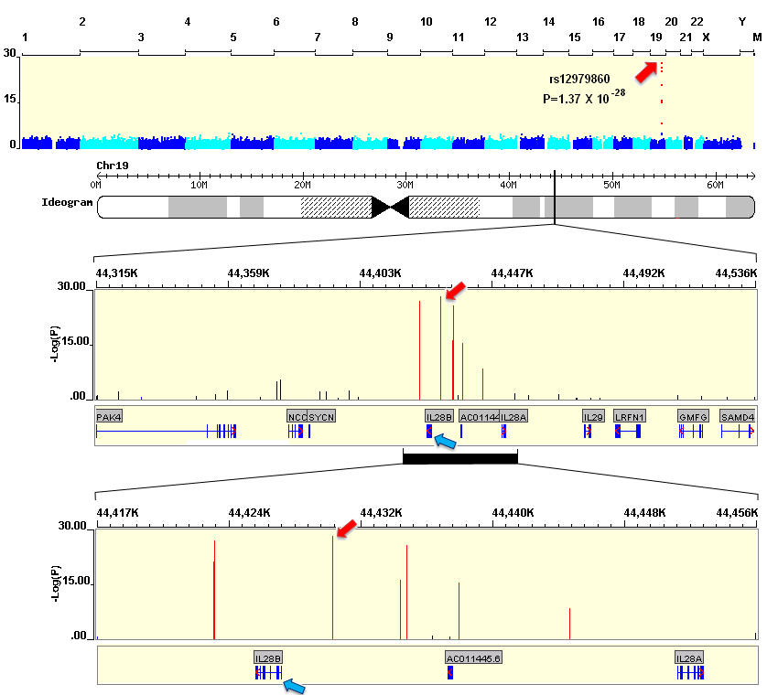
rs12979860 on chromosome 19
is strongly associated with SVR
Ge D. et al., Nature 2009

Slide 8
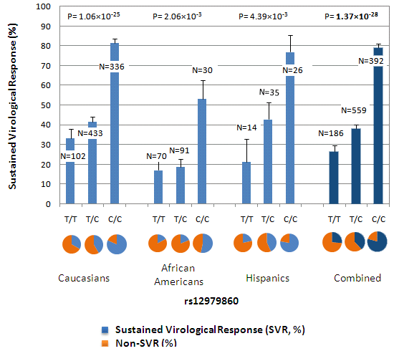
CC genotype at rs12979860 associates with a 2-3 fold greater rate of SVR than CT/TT genotype
Ge D. et al., Nature 2009

Slide 9
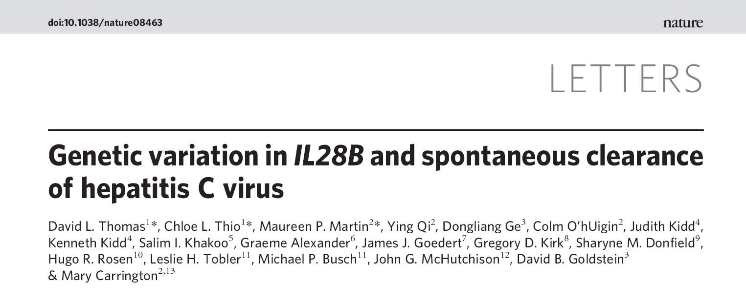
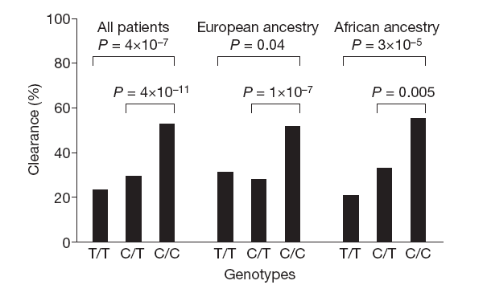

Slide 10
Correlation of genetic variation in IL28B with HCV recovery rates in diverse ethnicities
Different frequencies in IL28B variants explain ethnic differences in HCV recovery rates
Thomas DL et al. Nature. 2009.
Notes:
Ge and collegues observed a striking correlation between carriage of IL28B variants and the frequency of treatment response rates in diverse ethnicities. Thomas and colleagues have shown that an IL28B risk allele is more frequent in African populations, which is in line with poorer spontenous clearance rates in African populations. Taken together, different IL28B polymorphism frequencies explain at least in part differences in HCV recovery rates in diverse ethnicities.

Slide 11
What is the underlying biological cause for the genetic association?
Genome-wide association studies employ a “tagging” strategy but typically do not tell us what the causal variant(s) is/are
This requires other types of evidence: additional genotyping/association testing, and functional characterization of putatively causal variants
Leading hypotheses at the moment:
Regulation of IL28B/IFNL3 at the mRNA or protein level
Novel “IFNL4” protein (Prokunina-Olsson et al., Nature Genetics 2013)

Slide 12
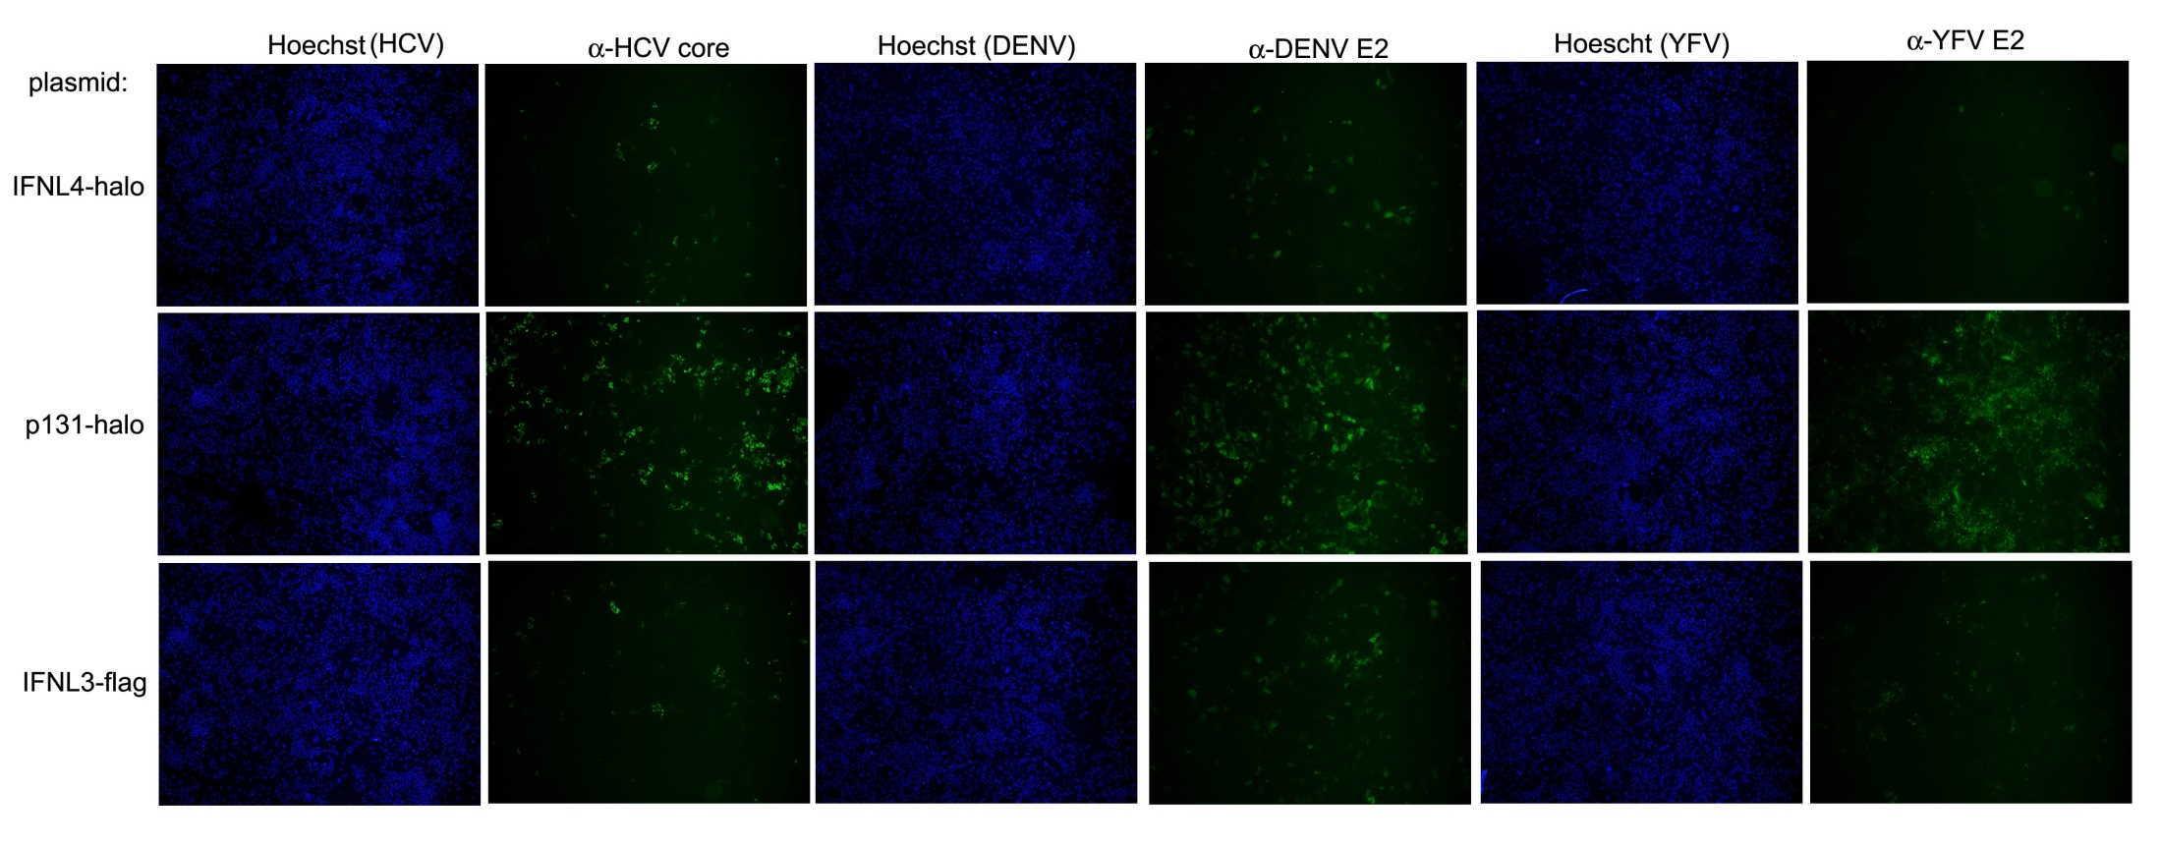
Broad antiviral effects of IFN-λ proteins
Shelton Bradrick, Molecular Genetics and Microbiology, Duke University

Slide 13
Host genetic studies in HepNet: current studies and next steps
Currently, DNA samples are available from approximately 500 individuals from Ghana and Nigeria
Proof-of-concept study:
Genotype IL28B/IFNL3/IFNL4 variants in these patients
Compare genotype distribution to public data from a West African population (HapMap YRI)
Test for association between genotype and spontaneous viral clearance (pending availability of outcome data)
Attempt to discriminate among candidate causal variants in the IL28 region by taking advantage of lower LD in African populations (will require much larger sample sizes)

Slide 14
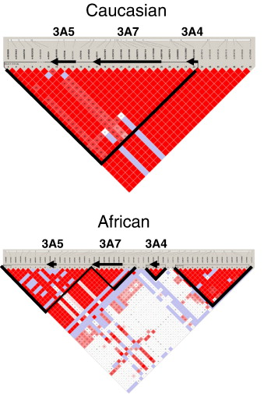
Linkage Disequilibrium Mapping in African vs European populations: advantages and disadvantages

Slide 15
DNA and Genotype Quality

Slide 16
Concordance with Published Data
IL28B/IFNL3 Genotype

Slide 17
Host genetics in HepNet: future opportunities
More detailed investigation of the IL28/IFNL region (targeted genotyping)
Genome-wide association study of spontaneous clearance
NOTE: there have effectively been no genome-wide studies of HCV clearance, either spontaneous or treatment-induced clearance, in African populations; thus, there remains every possibility of additional IL28-like (or stronger) genetic effects to be found in the HepNet host genetics program
The potential findings in such studies may well be generalizable to other viruses, other populations

